Slide 1

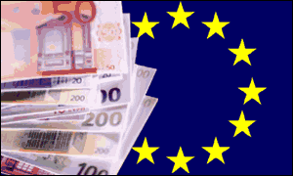
Euro-Mediterranean Partnership

Slide 2
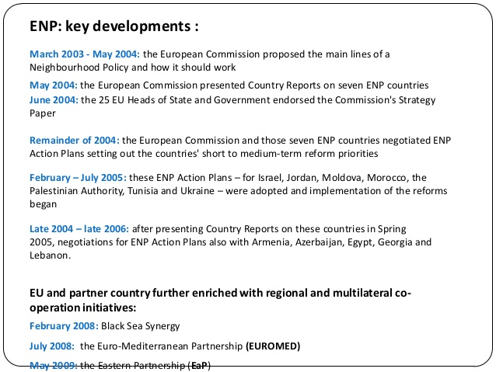

Slide 3
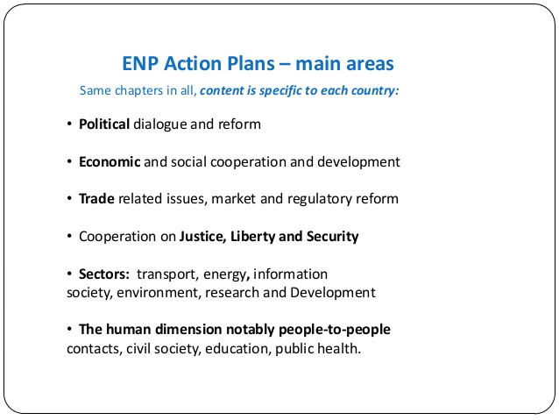

Slide 4

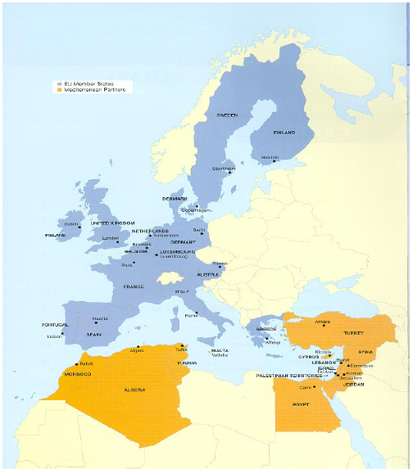
Introduction
The EMP is made up of the countries of the EU-25 and 10 Mediterranean Partners (Algeria, Egypt, Israel, Jordan, Lebanon, Morocco, Palestinian Authority, Syria, Tunisia and Turkey). Libya has had observer status since 1999.
Source: http://europa.eu.int/comm/external_relations/med_mideast/intro/index.htm

Slide 5
Mediterranean countries:
  In an unstable region
  Lack education and training institutions.
  - Lack financial structures to attract foreign capital

Slide 6
Recent History of Euro-Mediterranean Agreements
In 1976, the EC concluded bilateral agreements with three Maghreb countries: Egypt, Morocco and Tunisia
In 1977 the EC concluded bilateral agreements with four Mashreq countries: Egypt, Jordan, Syria and Lebanon
Direct aid and trade agreements formed the substance of these arrangements, and governed relationships up until 1996

Slide 7
Progress thus far
Bilateral Agreements Negotiated:
Tunisia (1995), Israel (1995), Morocco (1996) , Jordan (1997), Egypt (2001),
Algeria (2002), Lebanon (2002) and Syria (2004).
Bilateral Agreements Ratified:
Tunisia (1998), Morocco (2000), Israel (2000), Jordan (2002) and Egypt (2004)
Regional Agreements:
Arab Maghreb Union (Morocco, Algeria, Tunisia, Mauritania and Libya) signed in 1989. Seen
as a precursor of a North African Common Market.
Agadir Agreement signed in February 2004 by Morocco, Tunisia, Egypt and Jordan. This
expressed the intention to set up a free trade area, to meet the 2010 target. The Agadir
Declaration was signed in 2001, and was given €4m by the EU to develop.
Source: http://europa.eu.int/comm/external_relations/euromed/free_trade_area.htm

Slide 8
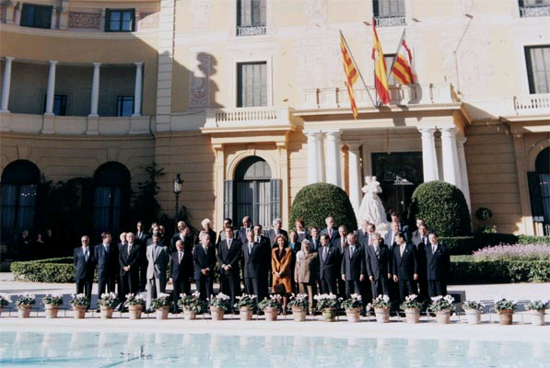
A New Beginning: The Barcelona Process
The starting point of the EMP, the Barcelona Process was inaugurated in November 1995
The stated aim was ‘to establish a comprehensive partnership among the participants the Euro­Mediterranean partnership through strengthened political dialogue on a regular basis, the development of economic and financial cooperation and greater emphasis on the social, cultural and human dimension, these being the three aspects of the Euro­Mediterranean partnership.’
Source: The Barcelona Declaration, available at
http://europa.eu.int/comm/external_relations/euromed/bd.htm

Slide 9
The ‘Barcelona Process’ started at the Euro-Mediterranean Conference of Ministers of Foreign Affairs, 27-28 November 1995
It aimed to establish a Euro-Mediterranean Free Trade Area (EMFTA) by 2010, through Association Agreements with the EU
At present, there are agreements between the EU and Tunisia, Israel, Morocco, the Palestinian Authority, Egypt, Algeria and Lebanon.

Slide 10
Structure of the EMP
Political
Economic
Cultural and Social
Creation of a free trade area by 2010
Gradual elimination of barriers and tariffs
Promoting private market mechanisms and the protection of rights
Economic cooperation and concerted action
Encouraging FDI inflows
Promote rural development through modernizing agriculture
Financial cooperation
Aid and developing macroeconomic policies for each country (MEDA)
Respect for international law and human rights
Develop the rule of law, while respecting territorial integrity
Respect diversity and promote tolerance
Prevent and combat terrorism
Attempt to prevent nuclear proliferation
Aim to create "area of peace and stability in the Mediterranean"
Promoting educational and cultural exchanges
Improving the health sector in the Mediterranean Basin
Developing the social sector through promotion of human rights
Controlling immigration through economic development
Conclude agreement on international crime and develop more effective immigration policies
Adapted from The Barcelona Declaration

Slide 11
MEDA
Principal financial instrument of EU for implementation of Euro-Mediterranean Partnership.
Manages co-operation with South-Mediterranean + Middle East countries
Offers technical + financial support measures to accompany the reform of economic and social structures in the Mediterranean partners
Programme applies to States, their local and regional authorities as well as actors of their civil society
Implemented by DG EuropAid
MEDA: 1995-1999 : €3,435 million
MEDA II: 2000-2006: €5,350 million
MEDA programme has a double vocation: bilateral and regional
Source: Europa website

Slide 12
2. How will Mediterranean countries be affected by a Free Trade Area with the EU?
Mediterranean countries may benefit in the long-run.
  Increased FDI (potentially).
  Workers become more skilled (more productive).
  More jobs, with higher wages.
Stand to lose out in the short-medium term
  Lower custom duties → higher domestic tax rates.
  Deteriorating trade deficits (Δ imports > Δ exports)
  Job losses, resulting from the opening of the heavily protected industrial markets of the Arab countries to EU exporters.

Slide 13

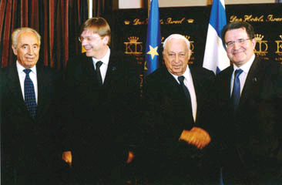
EMP: A Classic Case of
‘Soft Power’?
A Theoretical Perspective
Given the goals of the EMP, it seems clear that the EU is attempting to use
‘soft power’ through economic and fiscal instruments rather than military power
to solve potential problems.
Realist explanations for the nature of EMP:
Countering US influence in the region
Controlling the region through the creation of asymmetrical dependency
relationships
Containing the emergence of political Islam
Source: Crawford, B. ‘Why the Euro-Med Partnership? European Union Strategies in the Mediterranean Region’

Slide 14
Empirical Evidence: Trade
Source: UNCTAD Handbook of Statistics 2005 http://stats.unctad.org/Handbook/

Slide 15
Empirical Evidence: Freedom
House Rankings
Source: Freedom House, Freedom in the World Rankings
http://www.freedomhouse.org/template.cfm?page=15&year=2005

Slide 16
Barcelona Process- 3 criteria.
Regional integration- e.g. Agadir FTA agreement, Arab Maghreb Union.
Association Agreements
Financial Assistance-e.g.MEDA

Slide 17
Success or Failure?
Exports from the region to EU27 have increased by 10% per year (2000-2006).
Imports from the EU to region have risen by 4%. (2000-2006)
Trade between the two regions reached 120 billion euros in 2006.

Slide 18
Has EMP Been Successful?
Limited cooperation between the Mediterranean countries amongst themselves
Creation of dependencies on the EU, rather than bilateral processes: lack of MNMC representation
CEE enlargement has led to a squeeze on the potential goods and FDI investment. Originally a problem with Spain, Portugal and Greece, and potentially Turkey as well.
CAP prevents trade in agriculture, one of the key areas for the Mediterranean Basin countries
EU and Mediterranean region still progresses on the basis of bilateral rather than regional basis
Mediterranean region still heavily dependent on EU, suggesting that liberalization of the markets has not been fully achieved

Slide 19
Summary
‘In their search for a more effective Mediterranean policy, EU countries have faced the old dilemma of how to reconcile essentially political and security objectives with limited trade and financial instruments.’
Source: Tsoukalis, L. The New European Economy Revisited Oxford: OUP (1997) p.245

Slide 20
Sources
Panagariya, A. (2002) ‘EU Preferential Trade Arrangements and Developing Countries’
The World Economy 25 (10), 1415-1432.
McQueen, Matthew (2002) ‘The EU's Free–trade Agreements with Developing Countries: A Case of Wishful Thinking?’ The World Economy 25 (9), 1369-1385.
Crawford, B. ‘Why the Euro-Med Partnership? European Union Strategies in the Mediterranean Region’ in Aggarwal, V.K. & E.A. Fogarty (eds) EU Trade Strategies Houndmills: Palgrave MacMillan (2004)
http://stats.unctad.org/Handbook/
Laursen, F. ‘Trade and Aid’ in Cram, L., D. Dinan & N. Nugent Developments in the European Union Basingstoke: MacMillan(1999)
http://europa.eu.int/comm/trade/issues/bilateral/countries/tunisia/index_en.htm
http://europa.eu.int/comm/trade/issues/bilateral/countries/algeria/index_en.htm
Source: Bilateral trade relations.
Accessed: http://europa.eu.int/comm/trade/issues/bilateral/regions/euromed/index_en.htm
19:21 12/02/05.
Source: Making globalisation work for everyone-
Accessed: http://www.europa.eu.int/comm/publications/booklets/move/37/en.doc
17:00 12/02/05.
Trade-info.cec.eu.int/doclib/docs/2005/july/tradoc_122002.pdf
Trade-info.cec.eu.int/doclib/docs/2005/july/tradoc_113343.pdf
Richard Gillespie “A Political Agenda for Region-building? The EMP and Democracy Promotion in North Africa” (2004), (University of California, Berkeley)
Accessed: http://repositories.cdlib.org/cgi/viewcontent.cgi?article=1042&context=ies
19:08 13/02/06
Moïna Fauchier-Delavigne, Federico Costanza et Nadja Kamil, “The Med Academy”, 28.11.2005.
Translation : Kate Lee & Sarah Turpin
Accessed: http://www.cafebabel.com/en/dossierprintversion.asp?Id=234
Kevin Byrne “Euromed, an economic failure?”, 28.11.2005
Accessed: http://www.cafebabel.com/en/dossierprintversion.asp?Id=234
Christophe Schramm “Europe, fortress or promised land?”, 28.11.2005
Translation : Lucy Collins
Accessed: http://www.cafebabel.com/en/dossierprintversion.asp?Id=234

Slide 21
Thank you for your attention!

